Slide 1
Django 101
By Sebastián Lagomarsino. Mai 2021.

Slide 2
Facts

Slide 3
What is Django?
Django is a high-level Python Web framework that encourages rapid development and clean, pragmatic design. It’s free and open source.
The three key values of Django are:
Ridiculously fast.
Reassuringly secure.
Exceedingly scalable.

Slide 4
Django vs Django REST Framework
In simple words:
Django: It provide features for standard web app.
Django REST Framework: It provide features to build standard REST API.

Slide 5
Release
Django was created in the fall of 2003.
The latest stable version is 3.2, released on April 6th 2021.

Slide 6
Architecture
Django Framework can be seen as a MVC architecture.
It consists of an object-relational mapper (ORM) that mediates between data models (defined as Python classes) and a relational database ("Model"), a system for processing HTTP requests with a web templating system ("View"), and a regular-expression-based URL dispatcher ("Controller").

Slide 7
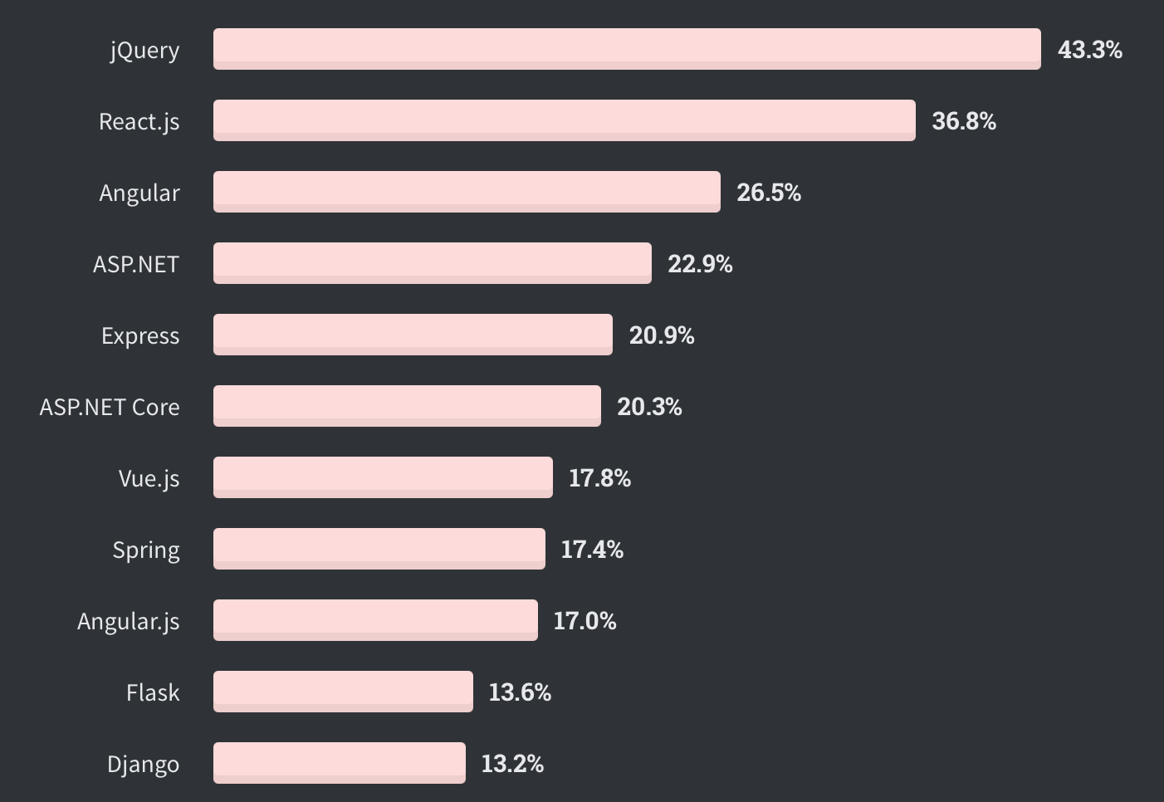
Django in the world
According a survey made by StackOverflow with 36,291 responses.

Slide 8
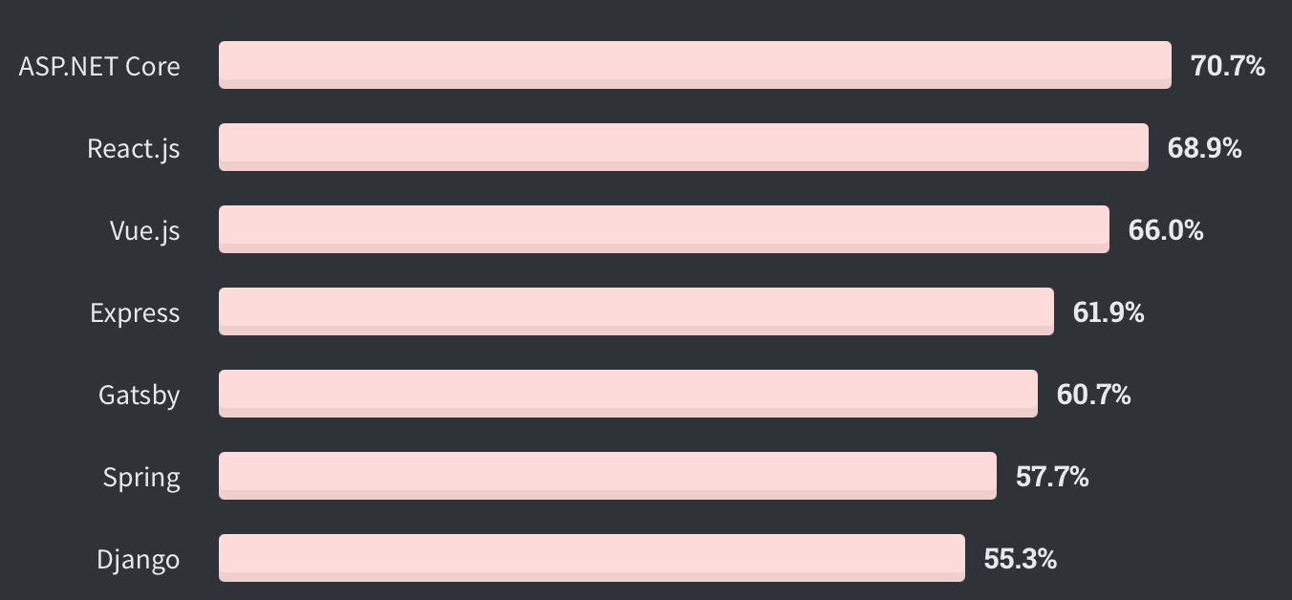
Loved
According a survey made by StackOverflow. % of developers who are developing with the language or technology and have expressed interest in continuing to develop with it.

Slide 9
Basics

Slide 10
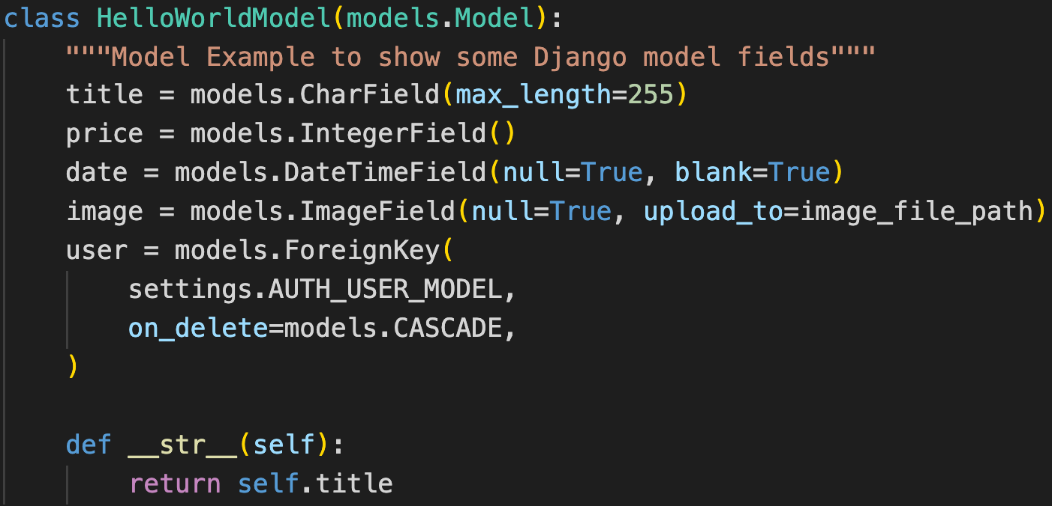
Models
A model is the single, definitive source of information about your data. It contains the essential fields and behaviors of the data you’re storing. Generally, each model maps to a single database table.

Slide 11
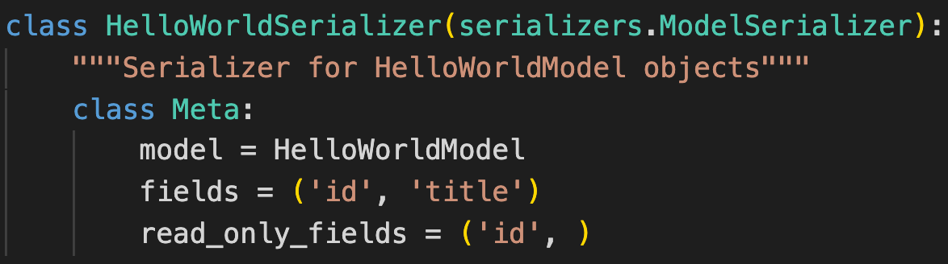
Serializers
Django’s serialization framework provides a mechanism for “translating” Django models into other formats.

Slide 12
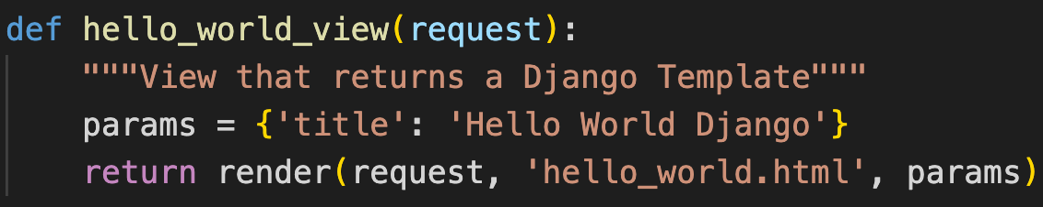
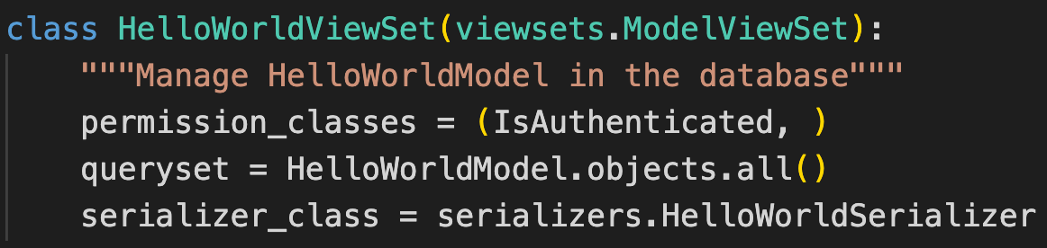
Views
A view is a callable which takes a request and returns a response.

Slide 13
viewsets.ModelViewSet
There are lots of viewsets, generics or mixins from which you can inherit in a View class.
An example of them is viewsets.ModelViewSet:
This class inherits from GenericAPIView and includes implementations for various actions, by mixing in the behavior of the various mixin classes.
The actions provided by this class are .list(), .retrieve(), .create(), .update(), .partial_update(), and .destroy().

Slide 14
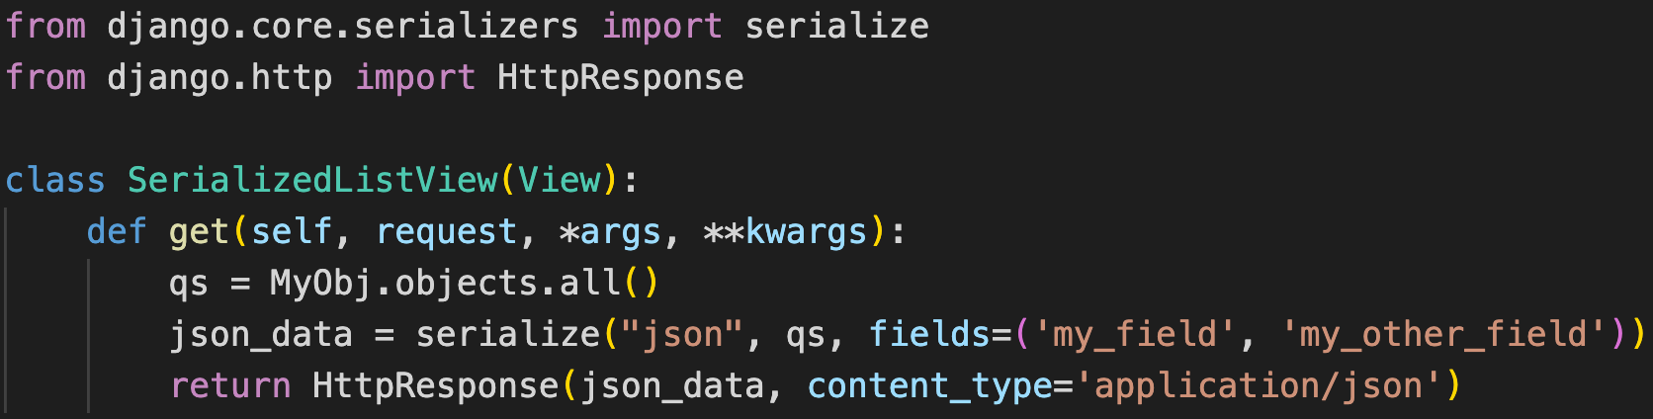
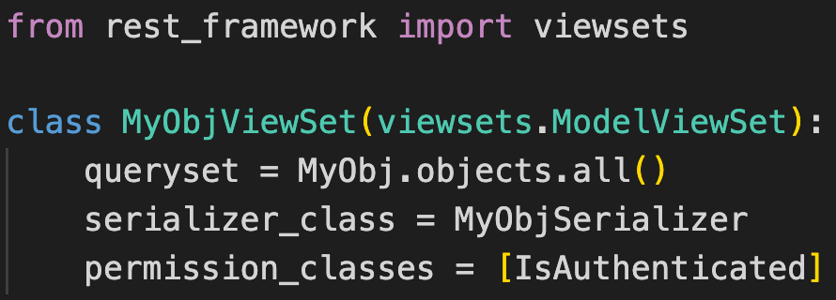
Using Django:
Using Django REST Framework:

Slide 15
Creating our first Django project

Slide 16
Docker

Slide 17
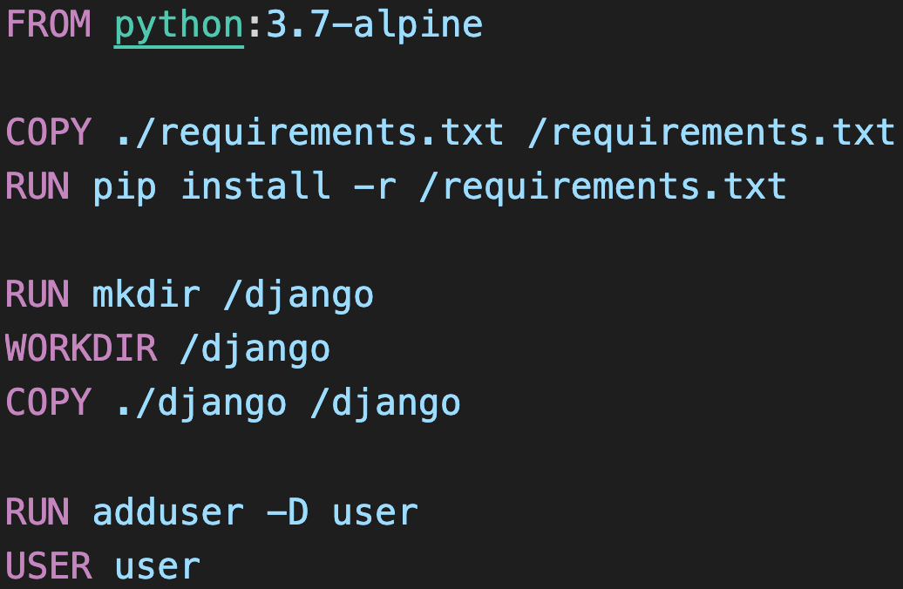
Creating DockerFile

Slide 18
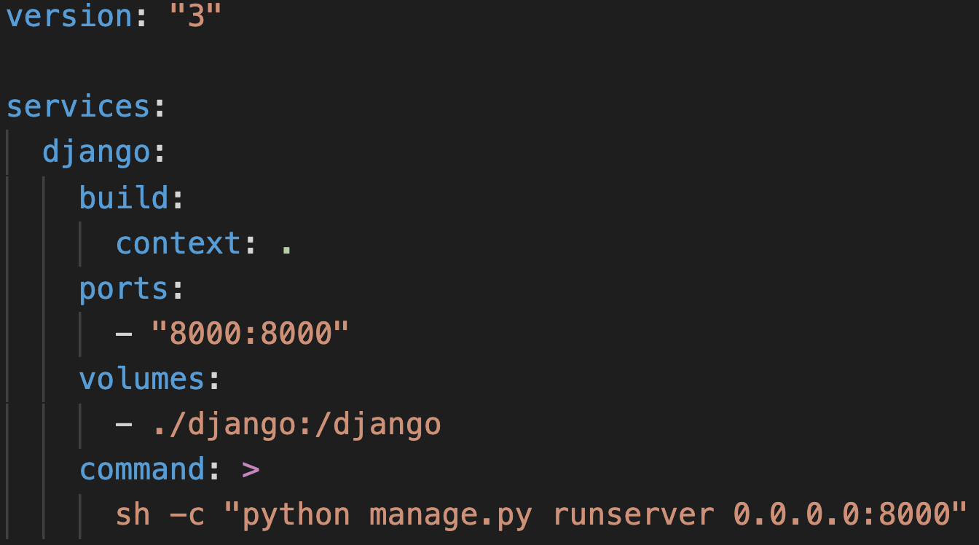
Creating docker-compose.yml

Slide 19
Useful Commands

Slide 20
Creating Django project

Slide 21
Creating Django app

Slide 22
Creating and running migrations

Slide 23
Demo

Slide 24
About
The demo contains one Django project with three Django apps:
hello_world: has a view that renders a Django template.
recipe: where you can manage Recipes with Ingredients.
users: where you can manage Users.
It provides a REST Api that we can make request in order to:
Recipes: create, list, update and delete.
Ingredients: create and list.
Users: create, get token, update.
It also has a Django Administration web page.

Slide 25
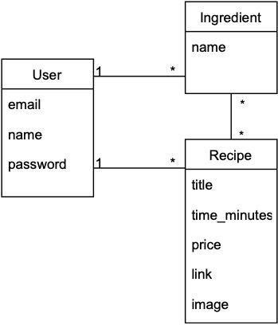
MER

Slide 26
Useful references
Views: https://docs.djangoproject.com/en/3.2/topics/class-based-views/
Serializers: https://docs.djangoproject.com/en/3.2/topics/serialization/
Models: https://docs.djangoproject.com/en/3.2/topics/db/models/
ViewSets: https://www.django-rest-framework.org/api-guide/viewsets/
Generic views: https://www.django-rest-framework.org/api-guide/generic-views/
Mixins: https://www.django-rest-framework.org/api-guide/generic-views/#mixins
Demo GitHub repository: https://github.com/slagomarsino/django-hello-world

Slide 27
Thank you :hug:

